Slide 1
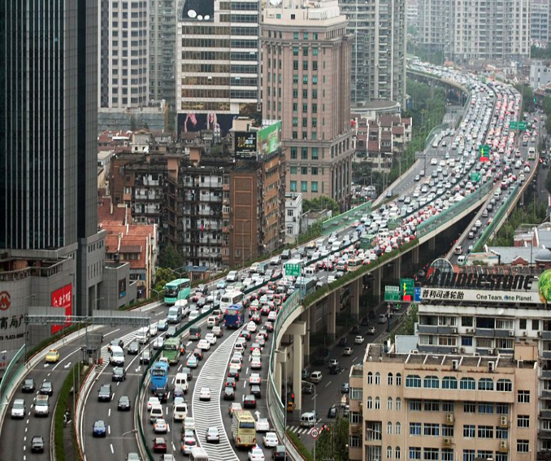
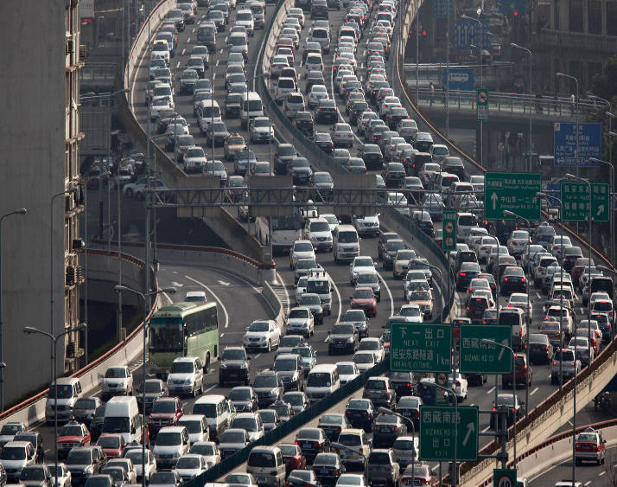
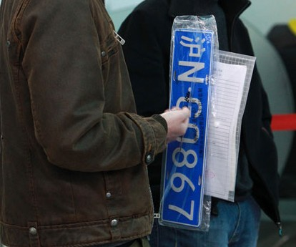
OPR9730 Term Project
Shanghai License Plate Auction Simulation
Baruch College | New York | April 2018
Tao Yang
Yang Jin
Yufan li
Sicheng meng
JJ Harrison (CC-BY-SA 3.0)
This presentation is for Baruch College Spring 2018 OPR9730 Simulation Class term project. All the information herein is based on publicly available data.
All rights reserved.

Slide 2
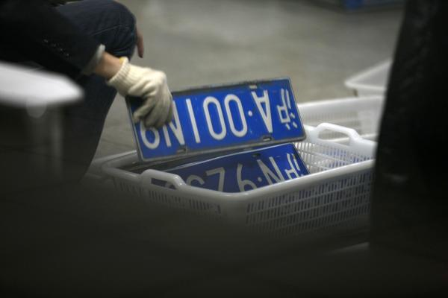
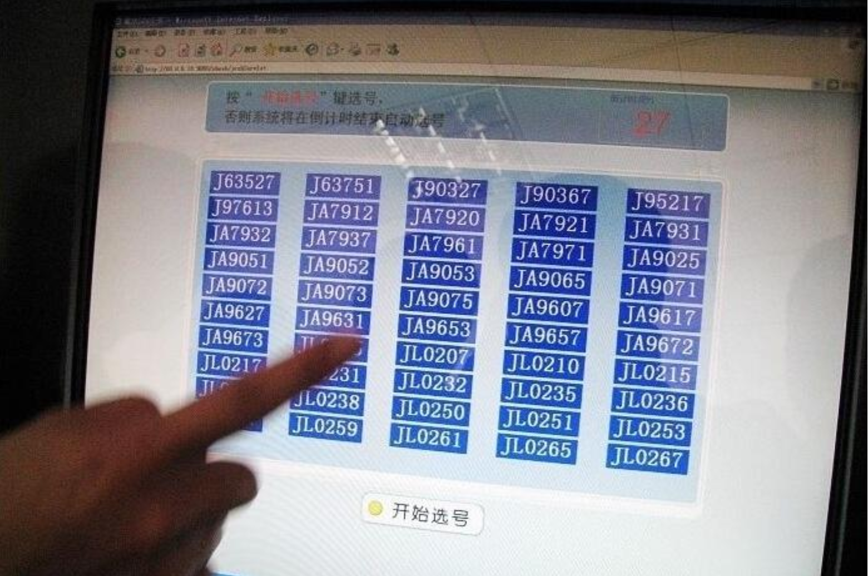
The Problem

Slide 3
Four Types of Traditional Auctions
Four types:
English Auction
Dutch Auction
First-price Sealed-bid Auction
Second-price Sealed-bid Auction
English Auction:
Open, oral, ascending-bid auction
Seller announces prices, or bidders individually state their bids
One winning bidder who bids and pays the highest price
Dutch Auction:
Descending-bid auction
Starts at an initial high price, then lowers the price continuously
The first bidder who claims he/she accept the current price wins
First-price Sealed-bid Auction:
AKA Blind auction
Bidders independently submit one single price
The highest bidder wins
First-price Sealed-bid Auction:
AKA Vickrey auction
Bidders independently submit a single price (blind bidding)
The highest bidder wins
The winner only pays the second highest bidder’s price

Slide 4

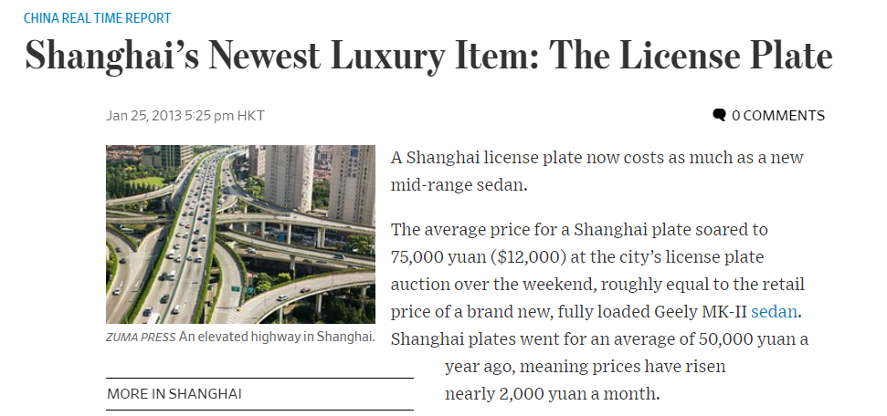

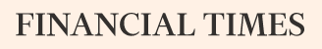
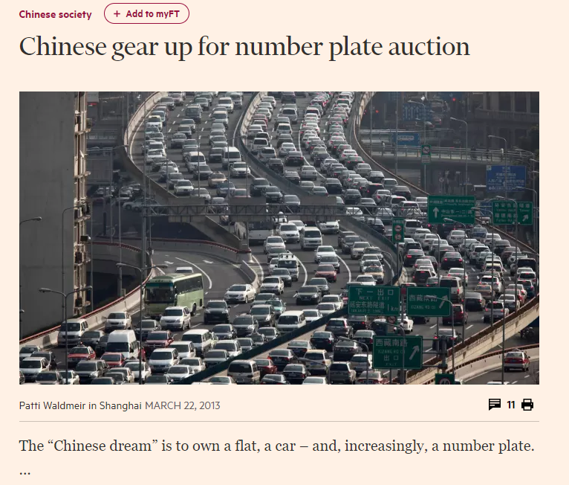
The $13,000 license plate has become a phenomenon and is well documented
The Real World Auction

Slide 5
Let’s walk through the mechanisms of the lightening fast auction- 8000 plates auctioned in 90 minutes
The Auction
The way to play is simple
Auction conducted online and all you need to do is to click +¥300 or -¥300 buttons
The winners are the highest k bidders
The current price in the Shanghai auction is the highest Kth bid according to the license quota K.
Two rounds of play
In the first stage, each bidder can submit a bid as long as it is not higher than the cap (warning price). The warning price for the year of 2017 is ¥86,000.
in the second stage, the bidders may revise their bids a maximum of two times within a narrow price interval. A revision in the second stage can only be in the range of the current price of ±300 RMB. Bidders who bid higher or equal to the final current price win and each winner pays their bid in order to purchase a license.

Slide 6
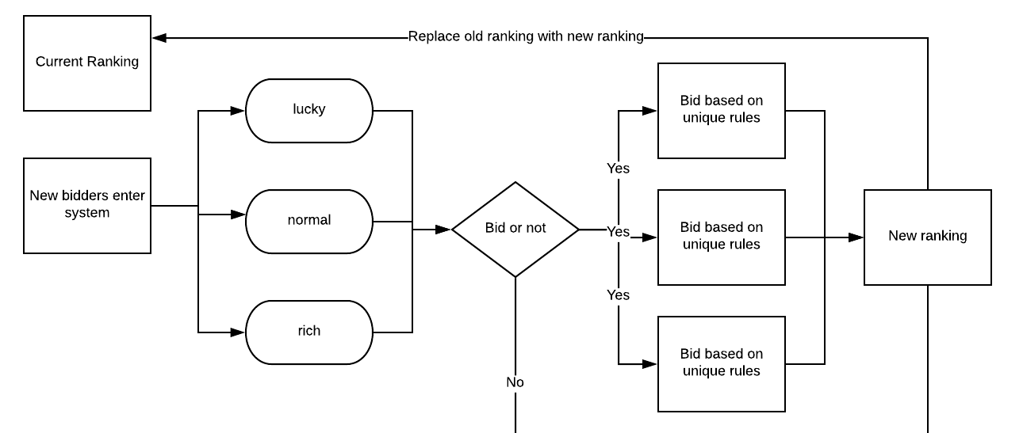
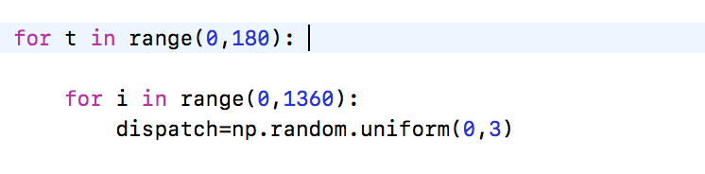
Actual simulation process
Simulation Breakdown
Time Interval
30 minutes -> 180 intervals, every interval takes 10s
Realization: for loop in Python
Reason: simulation the delay in internet, system etc.

Slide 7

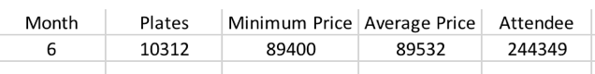
Bidder generation process
Bidder Creation
Generate 1000 bidders into the system per interval
number of bidders changes according to actual total number of the bidders
244260 = 180 * 1357
Assign Types
Divided into 3 types of bidders
Assign a random number
Uniform(0,3)
0~1 -> lucky
1~2 -> normal
2~3 -> rich

Slide 8
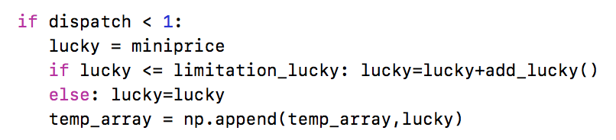
“Lucky” bidder assumption:
Bidding rules: “Lucky”
Start from minimum winning price
Only add no more than 300 A random uniform distributed number (0, 300)
Maximum bidding price = 87600 If higher, bid 87600 repeatedly

Slide 9
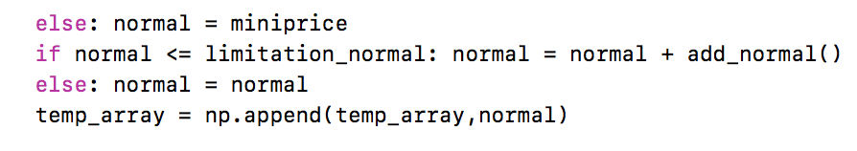
“Normal” bidder assumption:
Bidding rules: “Normal”
Start from minimum winning price
Add no more than 600 Uniform random (0, 600)
Maximum bidding price = 90209 If higher, bid same

Slide 10
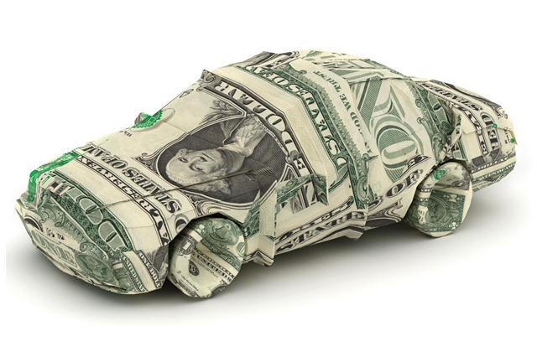
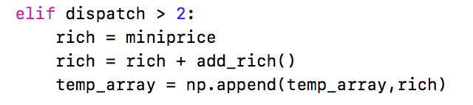
Bidding rules: “Rich”
“Rich” bidder assumption:
Start from minimum winning price
add no more than 900 uniformed random number (0, 900)
No Maximum!

Slide 11
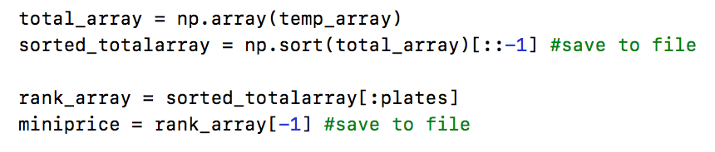
New minimum winning price
Final Step
all appeared price will be saved in system and file
1000 different bidders -> 1000 new price
Combine together and sorted
Plates 10312 -> rank 10312 -> new minimum price

Slide 12
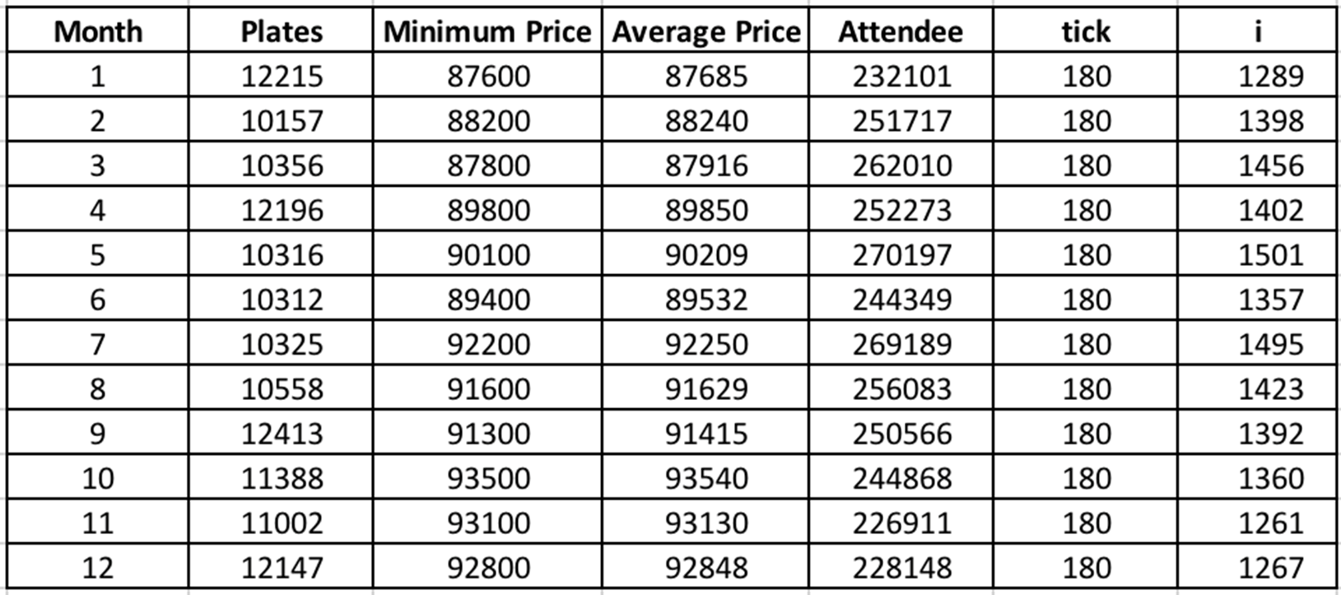
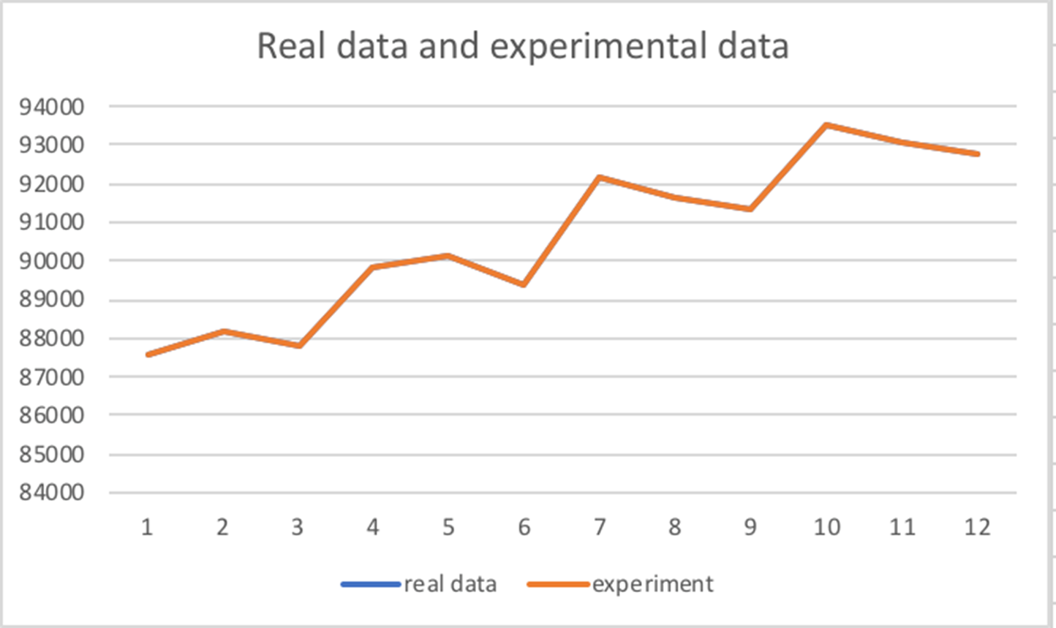
Data and Expectation

Slide 13
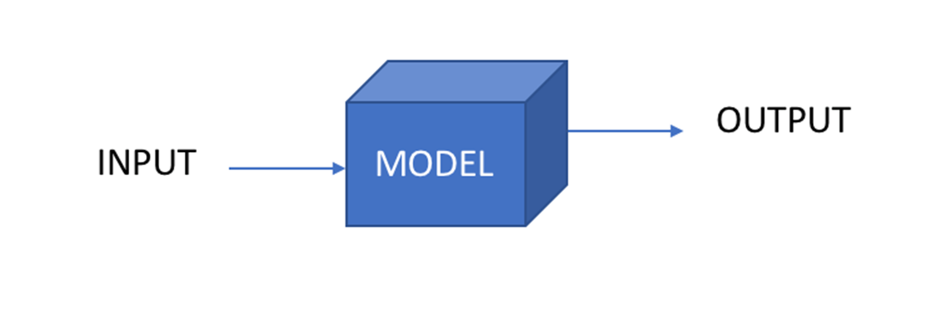
Validation Methods
Control Variables
Binary Methods

Slide 14
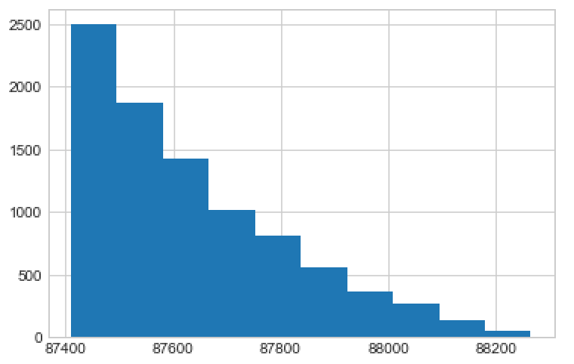
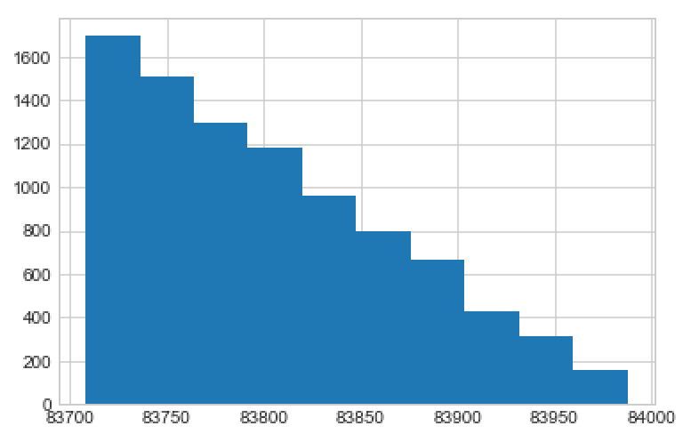
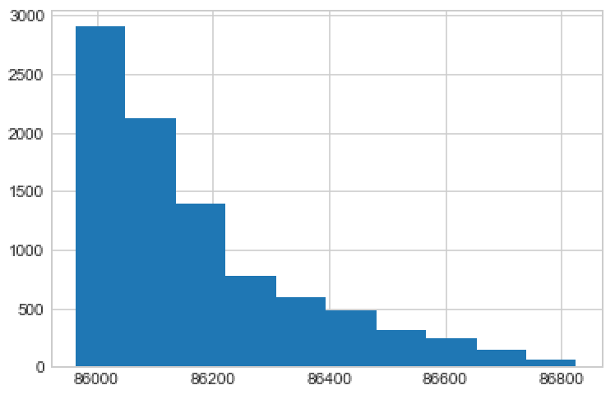
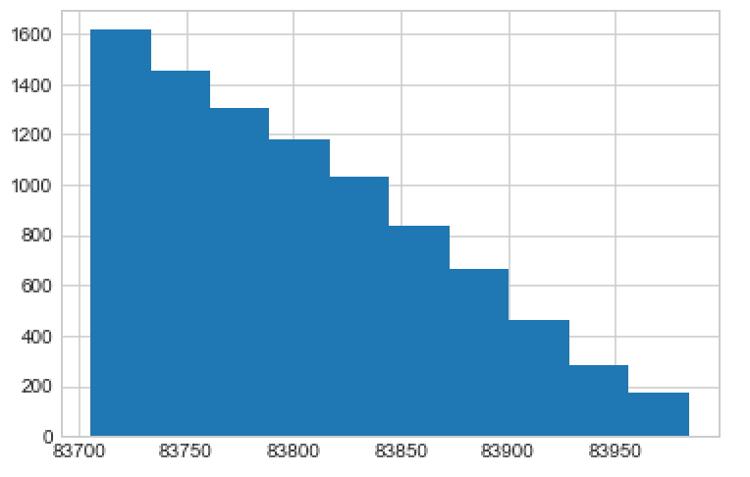
Validation Sample
Uniform Distribution
MIN: 87410.49678
AVG: 87636.21962
Exponential
Distribution
MIN:83708.2604276
AVG:83803.7227566
Normal Distribution
MIN:85963.8549715
AVG:86169.3506785
Gamma Distribution
MIN: 83705.5016278
AVG: 83802.3192582

Slide 15
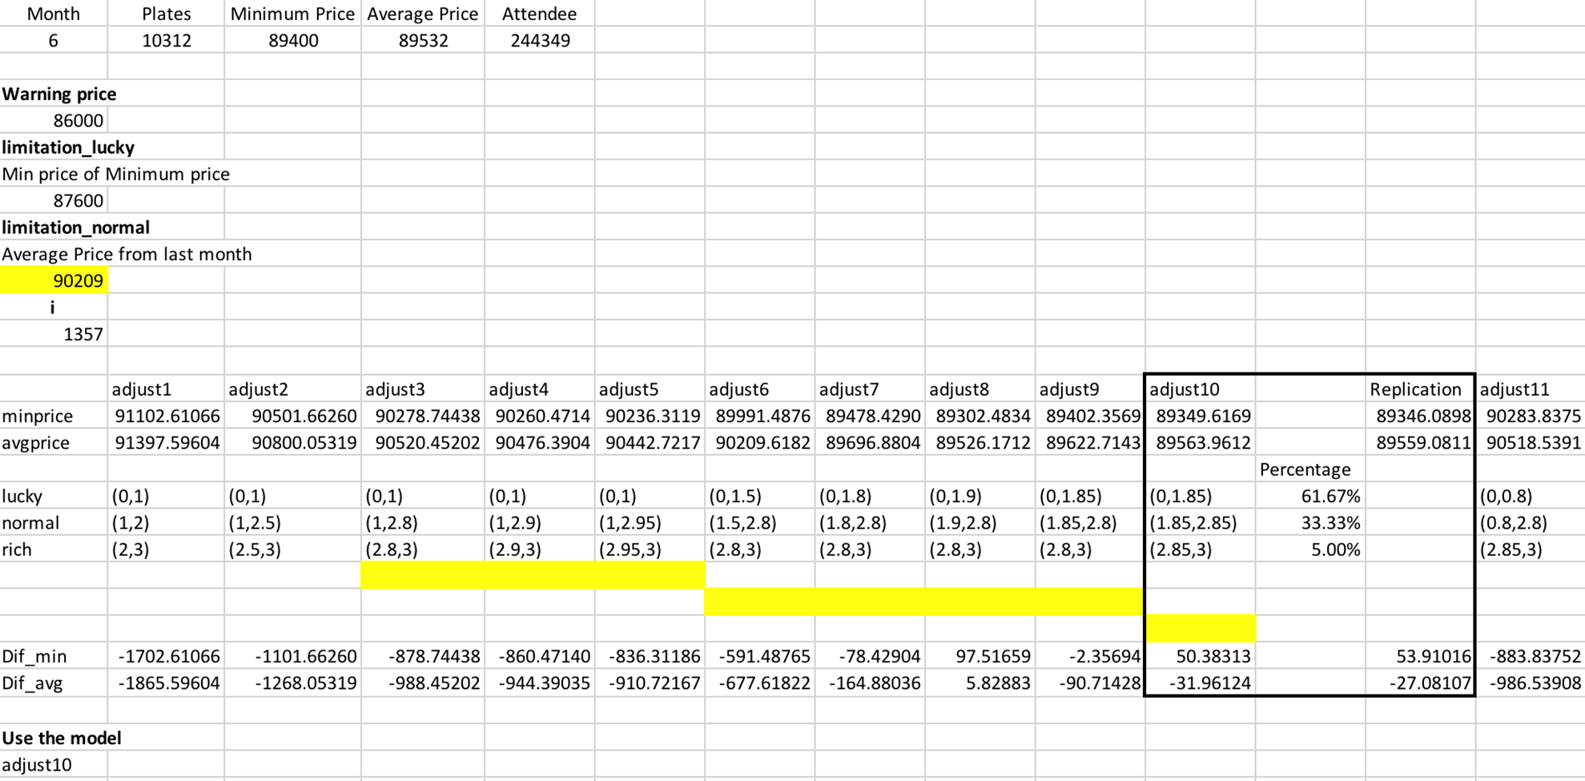
Validation Sample

Slide 16
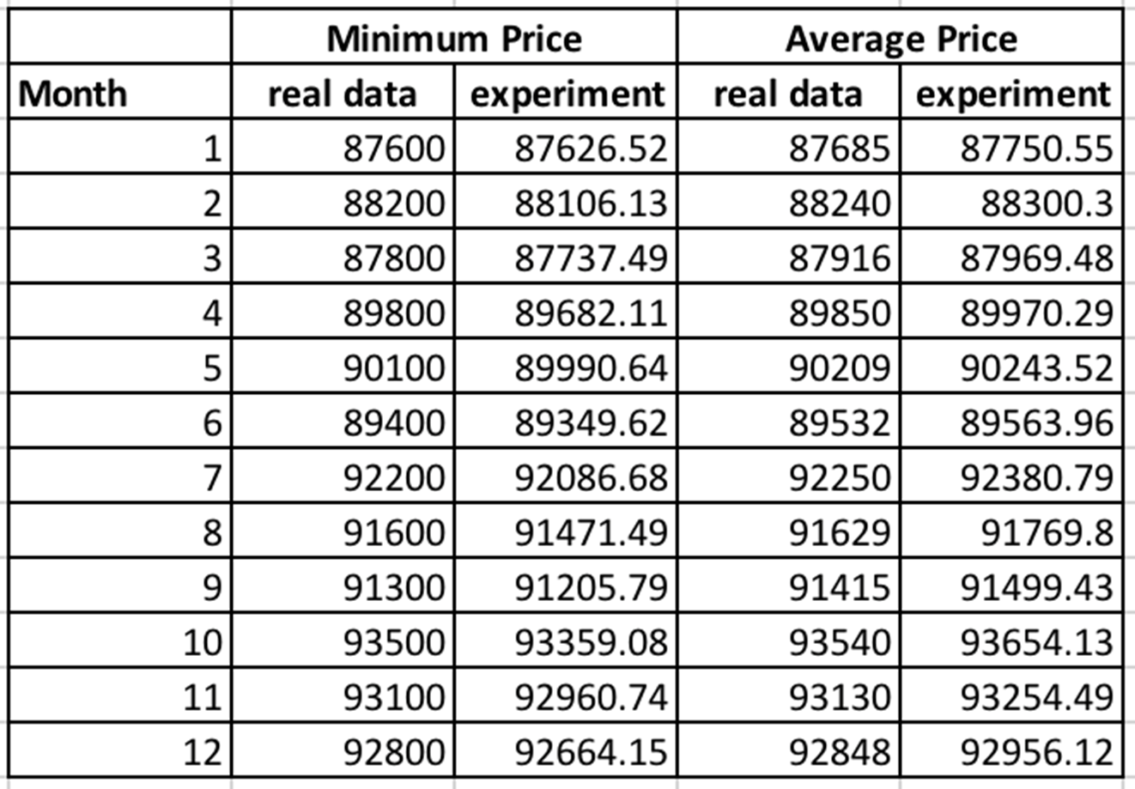
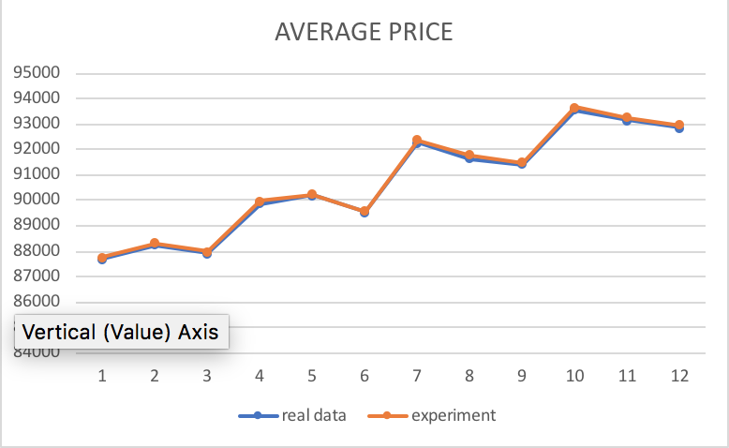
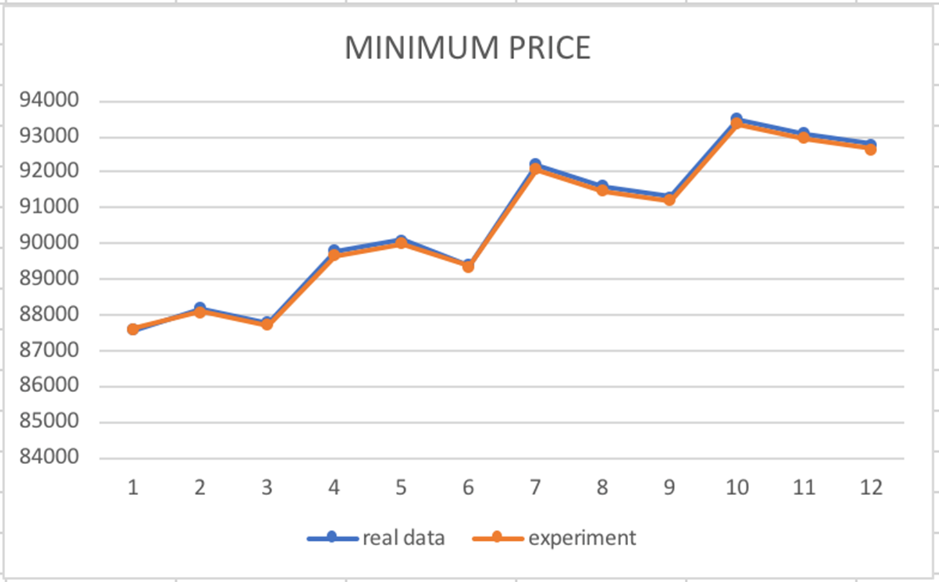
Output Comparison

Slide 17
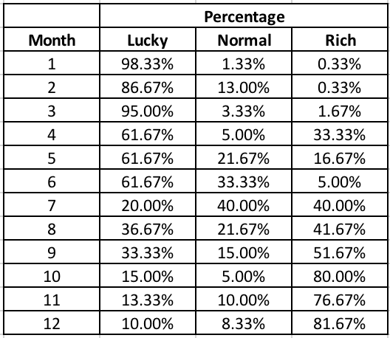
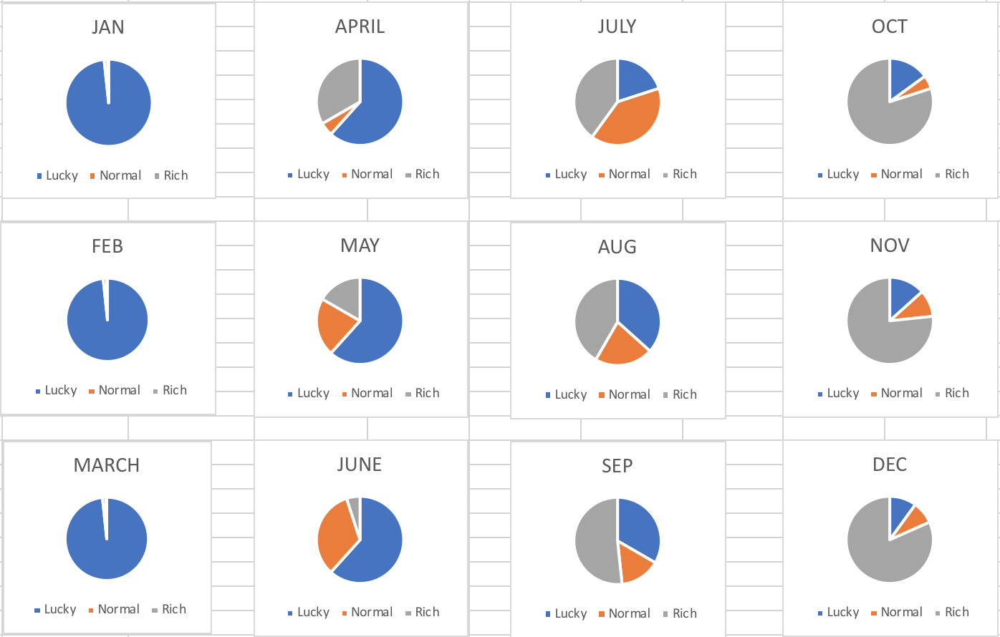
Input Analysis

Slide 18

Potential Improvement
Current Limitations:
Increase speed of the program, more replication
More years’ data could be used
Different parameters, distribution
More people in the end of the auction

